Slide 1
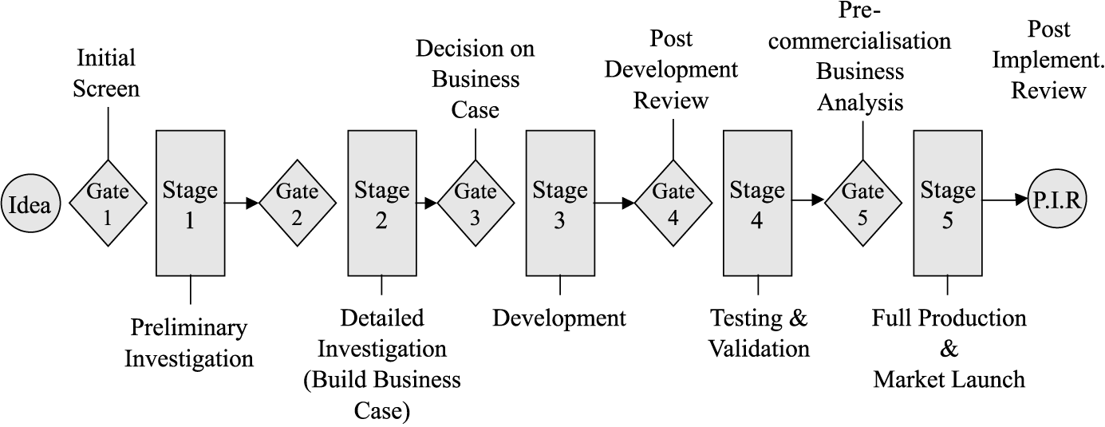
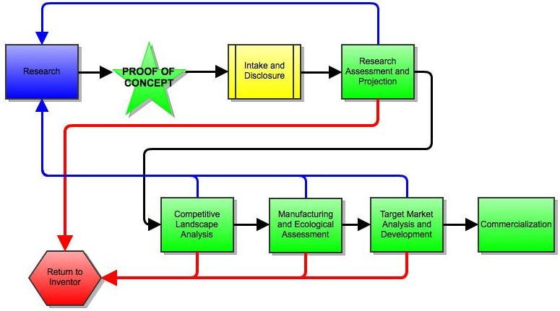
Commercialization of AMP Technologies through Improving the Stage-Gate Process
Kenzy Pinney, Dr. Jennifer Karlin, Dr. Christian Widener
South Dakota School of Mines
Industrial Department
Material & Metallurgical Department
Research Made Possible by
NSF REU Award # 0852057
http://www.emeraldinsight.com/journals.htm?articleid=1463188&show=html
Abstract
(Figure 1)
Results
The Stage-Gate Process is a development organization tool used to increase the success rate of the construction and choice of good ideas and innovations, causing it to be the world’s most widely implemented and trusted product innovation process. The unique feature of the process is the prearranged formation of diverse research or action periods that are called stages. And decision points called gates. Although the original process may be the world’s most widely and trusted product innovation process, there has been many controversies over the process at the South Dakota School of Mines & Technology that need to be resolved. The development of the System for Entrepreneurship and Economic Development, SEED, resolves the controversies here at the South Dakota School of Mines & Technology.
In the original Stage-Gate Process, it was found that there was a lot of pathways that did not need to be followed or that needed to be followed, a condensed overview of the process was needed, and the needs needed to be expanded to the public.
Working with a group of Students (undergraduates, graduates, PhD) and administration; an improved Stage-Gate Process is developed, the System for Entrepreneurship and Economic Development (SEED). (figure 2)
(Figure 2)
Objectives
Conclusion
Study an actual case study from the AMP center.
To produce an enhanced Stage-Gate Process that is produced specifically for South Dakota School of Mines & Technology faculty and students.
Commercialization of AMP technologies, such as Friction Stir Welding and Cold Spray.
Going through the original Stage-Gate Process made it possible to develop SEED. The shift to the new system integrates the needs stated by the shareholders by developing a simpler process that is easier to remember and also allows the people who are working through the process a more systematic way of moving from one stage to another.
Procedure
Future Work
Take the AMP case study through the original Stage-Gate Process (figure 1).
Analyze what could be improved in the original Stage-Gate Process
Create an improved Stage-Gate Process that fulfills the South Dakota School of Mines & Technology’s needs.
Continued improvement of the SEED process could be applied to the individual fields at the South Dakota School of Mines & Technology. Each field could have a different process that pertained to what was needed by the certain field.
Different case studies can be performed through the same process to see if the same changes that were needed to be done to the original Stage-Gate Process reoccur in different case studies.
Broader Impact
Economic history demonstrates that America’s economy enhances when science, technology, and industry in the country and nation enhances. The research created an improved design for analyzing intellectual processes from the AMP Center. This development of a better-quality Stage-Gate Process will enhance commercialization of AMP technologies which will lead to an enhancement of science, technology, and industry; eventually leading to an improved economy.

